Slide 1
Data Analyst Nanodegree
Session 5
Conducted by: Hamza
Notes:
https://udacity.zoom.us/j/7991233356
144

Slide 2
Agenda
Hypothesis testing
P-valuse
Confidence interval
Classical tests
Central limit theorem
bootstrapping
Mobile game project

Slide 3

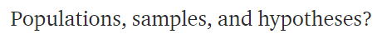
Statistics
Notes:
Most important question in statistics?
144

Slide 4

Default action

Slide 5


Notes:
Search for aliens on a planet ur manager is waiting for a report that has only this.
Yes or no
144

Slide 6

Notes:
Oxygen almost finised
U won’t be able to discover the whole planet
Uncertainty
What if I didn’t find info, shall I answer with yes or no?
144

Slide 7
Default action
Notes:
U can choose any.
In fact it is an MBA question that has to deal with decision maker not with numbers
It is a decision taken while relaxing on a coach
144

Slide 8

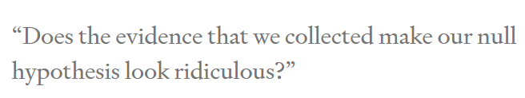
Alternative action
Notes:
If u choose NO as the default action or null hypothesis
Then u won’t choose yes except if data makes pressing no feels ridiculous
144

Slide 9
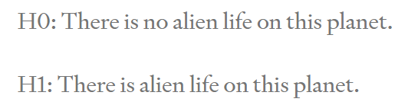

Slide 10


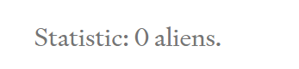
Collect data
Notes:
Thus no aliens on planet
Is it fair ?
U could have missed an alien that u didn’t see
144

Slide 11


Statistics
Notes:
Legal contract
We are only interested in population
Anything related to our sample is boring
144

Slide 12
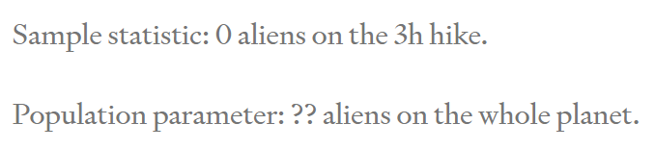
What did we learn?

Slide 13
What did we learn?
Notes:
Analytics can very easily find interesting results as we simply examine the sample only
144

Slide 14
Notes:
Medical oncology doctors
Search for a significant p value
144

Slide 15
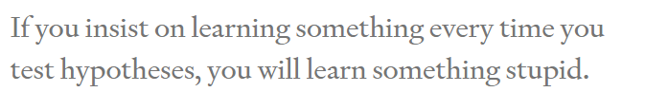

Slide 16
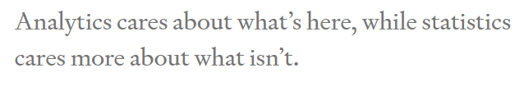

Notes:
Prof tom
The estimate is not the important thing
How confident are u with the estimate
144

Slide 17
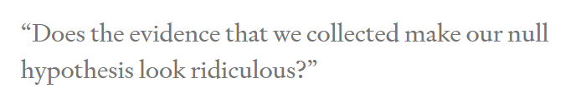
When to change mind?
Notes:
Making decisions based on facts (parameters) is hard enough as it is, but -curses!- sometimes we don’t even have the facts we need. Instead, what we know (our sample) is different from what we wish we knew (our population). That’s what it means to have uncertainty.
144

Slide 18

Notes:
Supposing it’s an alien not anything else
Found an alien
144

Slide 19
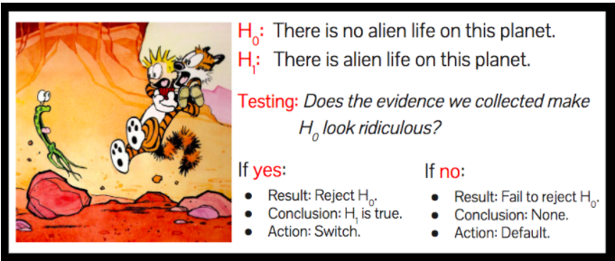
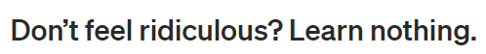
Notes:
144

Slide 20
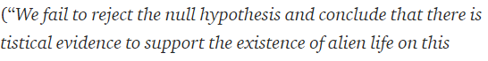


Slide 21


Actions vs learning
Notes:
Tragedy for learning nothing
We were not here to learn. We were here to take actions.
We have taken a sensible action based on data. We choose the wisely selected default action
144

Slide 22



Notes:
Why do the stats from the beginning ?
We could have laid down and choose the dafault button
Because u have actually worked hard, in a fairly manner, attempting to change ur mind if u get enough data.
Thus when u choose the default action now, u choose it wenta dameerak merta7
Ma3 enak 3aref en mmken yekoon kararak ghalat (uncertainty) bs this is the best u can do
And that’s why it is always good to increase sample size
To recude type 1 and type 2 errors
144

Slide 23
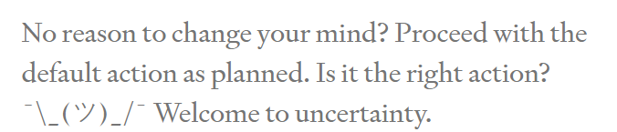
Am I right?
Notes:
144

Slide 24



How to measure “ridiculous”?
Confidence interval
P value
Notes:
Is the yelling enough to change ur mind?
The lower the p value
The more yelling at me
Leave the default action
How to measure yelling?
Compare to a preset significance level
This level determines how much risk u tolerate to take
If u set it to zero
U refuse to leave the default action
Don’t do statistics
The definition of a p-value is the probability of observing your statistic (or one more extreme in favor of the alternative) if the null hypothesis is true.
144

Slide 25


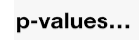
الملتقى
Classical tests( t test/ chi square / ANOVA/ .. )
Central limit theorem
Bootstrapping
Newer tests
Notes:
144

Slide 26
Difference between ci and p value?
Coming soon isA..

Slide 27
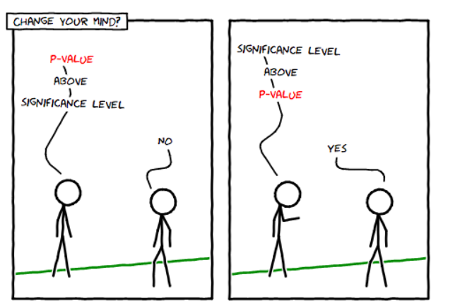

Slide 28
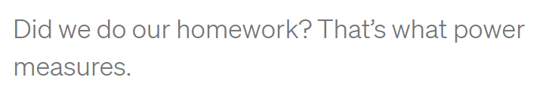

Notes:
3 hours were not enough
What about 30 sec
Easy to stick to default action, but results would be misleading
U didn’t do ur hw
The more u have the more opportunity u have given urself to change ur mind if that’s the right thing to do
144

Slide 29


1000000 hours
Notes:
Why not spend 1000000 hours
Balance between money and effort and time and benefit
144

Slide 30

Change default action
Pick YES?
Read the links for the answer ☺
Notes:
144

Slide 31
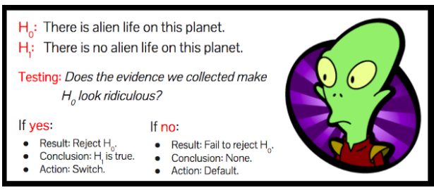

Slide 32
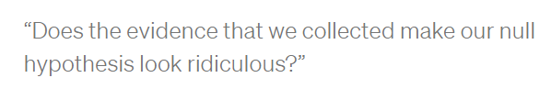
MAIN QUESTION
Notes:
144

Slide 33

Default action
!! What to expect??
Notes:
144

Slide 34
Answer is No. Always!
Notes:
Suppose we see an alien. Is our null hypothesis ridiculous? No, of course not. How about if we hike for three hours and we see no aliens? Is the null hypothesis of alien life ridiculous? Still no. (If you’re struggling with this, you should really go hiking on planet Earth some time. It’s easy to go three hours without seeing other humans…)
Evidence never make the null hypothesis ridiculous
144

Slide 35

2 OPTIONS
OR Every corner
sometimes we can see the answer. .No need to calculate
Notes:
Work from home
Or gather entire population! (that’s not statistics)
144

Slide 36
Bottom line!
Start with default action. Choose wisely!
Don’t have default action? No need for statistical inference!

Slide 37
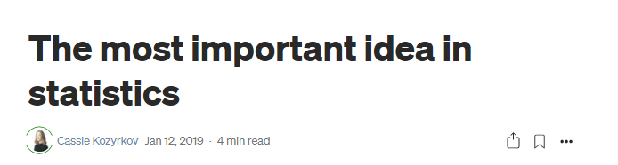
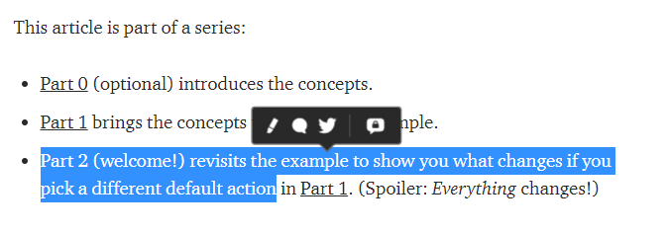
Notes:
The most important idea in statistics | by Cassie Kozyrkov | Towards Data Science
https://towardsdatascience.com/the-most-important-idea-in-statistics-8c18d514ad1c
Statistical inference in one sentence | by Cassie Kozyrkov | HackerNoon.com | Medium
https://medium.com/hackernoon/statistical-inference-in-one-sentence-33a4683a6424
144

Slide 38

P values

Slide 39

Setting the scene

Slide 40
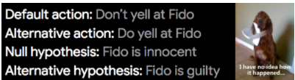

Slide 41
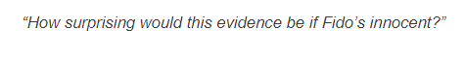
Describe the null world
Answer is pvalue
Notes:
What we’re doing here is visualizing the null hypothesis world and figuring out how things work there so we can make a toy model of it. That’s what the calculations are all about.
144

Slide 42

Little monster
Notes:
144

Slide 43

Living alone
Notes:
144

Slide 44
conclusion
“If I’m living in my default action world, how surprising is my evidence?”
p-value low enough ➔ change my mind

Slide 45

But which is small enough?
0.06
0.04
0.01
0.00001
Notes:
We need a reference!
144

Slide 46

Notes:
My friend from animal friends.co argues with me
5% yelling by error would be too much
144

Slide 47
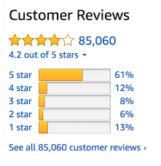
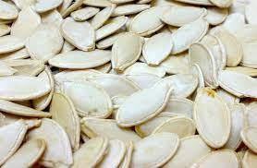
Take the decision for threshold in advance!!

Slide 48
0.05 threshold
5% of times. Wrongly change ur mind FALSE POSITIVE

Slide 49
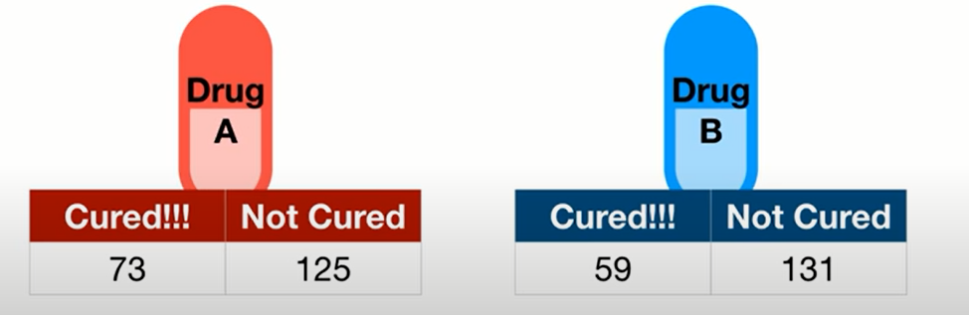
0.05 threshold
What’s the null hypothesis?
5% of times. U will decide they’re different. [while they are not different]
FALSE POSITIVE
Notes:
Null hypothesis: drugs equal
144

Slide 50
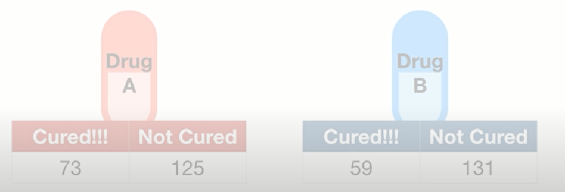
Critical drug!
0.01 threshold
1 False positive every 100 experiments
Notes:
If it’s extremely important to avoid false positive, use a lower threshold
144

Slide 51
Ice cream arrival on time
0.2 threshold
20 False positive every 100 experiments
20% of times. Wrongly change ur mind FALSE POSITIVE

Slide 52
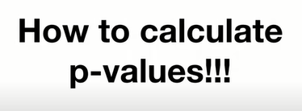

Slide 53
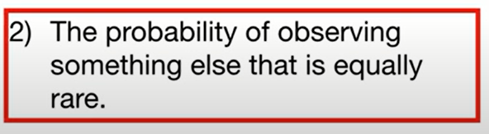
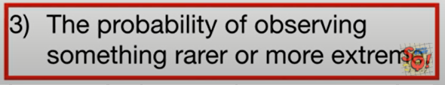
Two sided p value
As extreme, or more extreme
as the data
Notes:
144

Slide 54
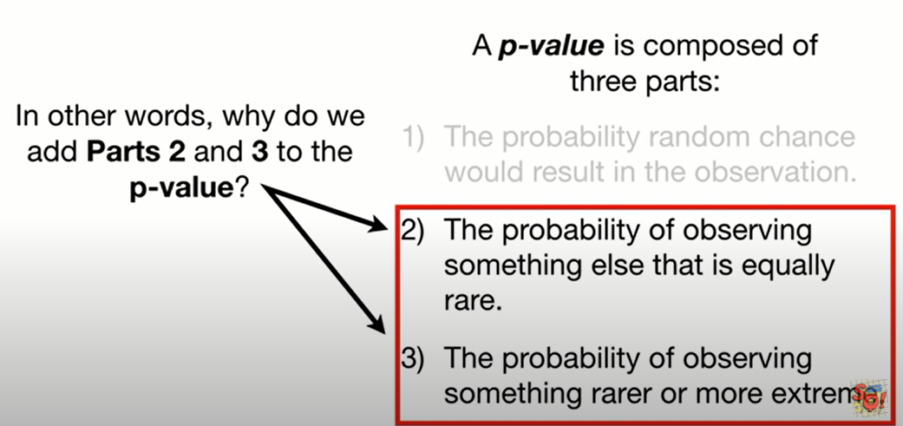

Slide 55

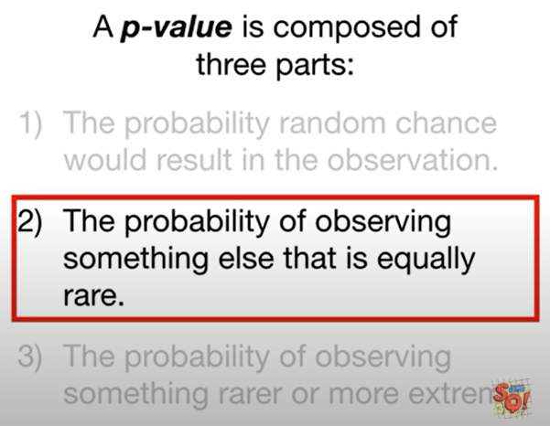

Why add part2?
Notes:
U told ur wife, that’s the rarest flower
She will be surprised
She may give u her jewelery (shabka)
144

Slide 56

Why add part2?
Equally as rare
Notes:
She won’t be that surprised. Even if the flowers are different. The event is not rate anymore
144

Slide 57

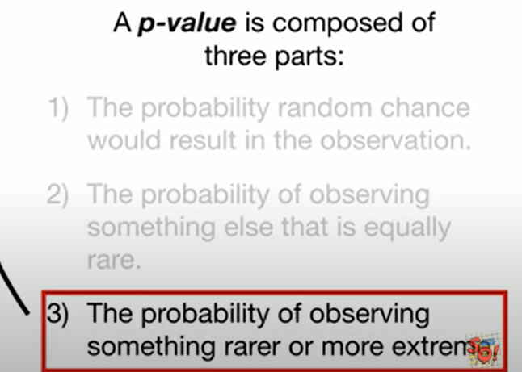
Why add part3?
More flowers are rarer than this flower
Notes:
Again, she won’t be surprised
144

Slide 58

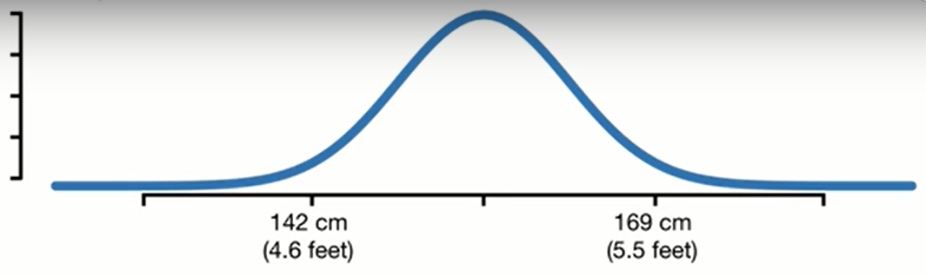
experiment

Slide 59
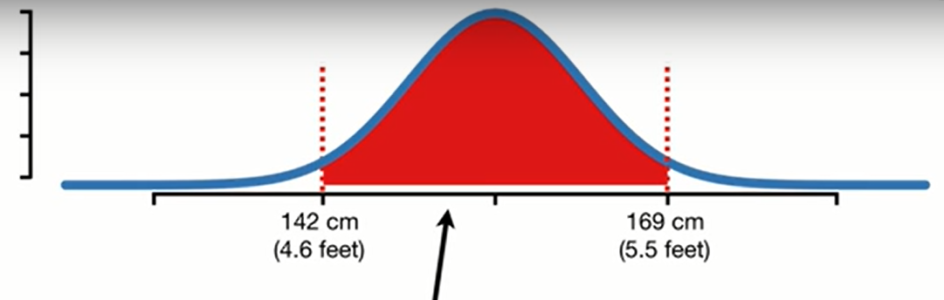
95% CI

Slide 60
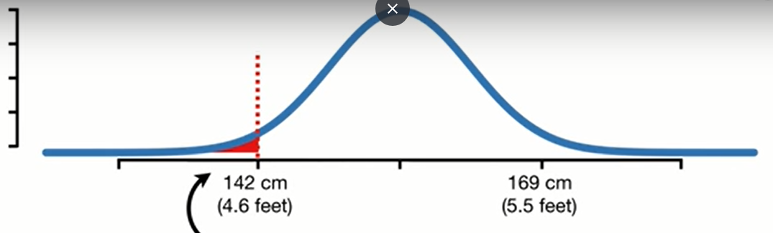
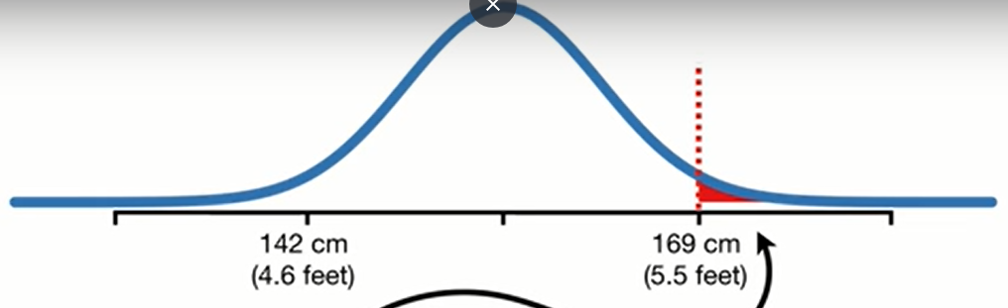
Notes:
2.5% at each side
144

Slide 61
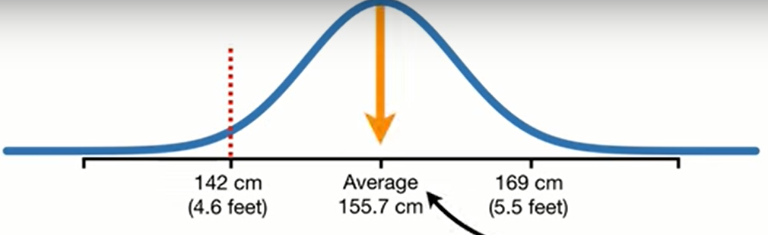
belong to NULL HYPOTHESIS WORLD?
Alpha = 0.05
Null : population average = 155
Notes:
We measure a person height to be 142cm
Does it belong to this distribution that has a mean of 155.7?
144

Slide 62
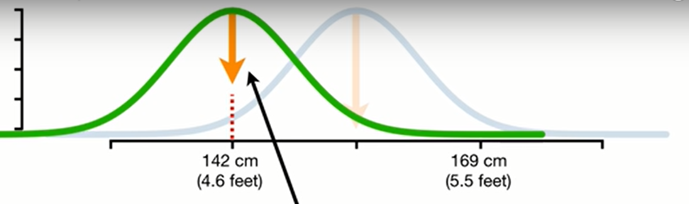
OR ALTERNATIVE HYPOTHESIS WORLD?
Alternative: population average != 155

Slide 63
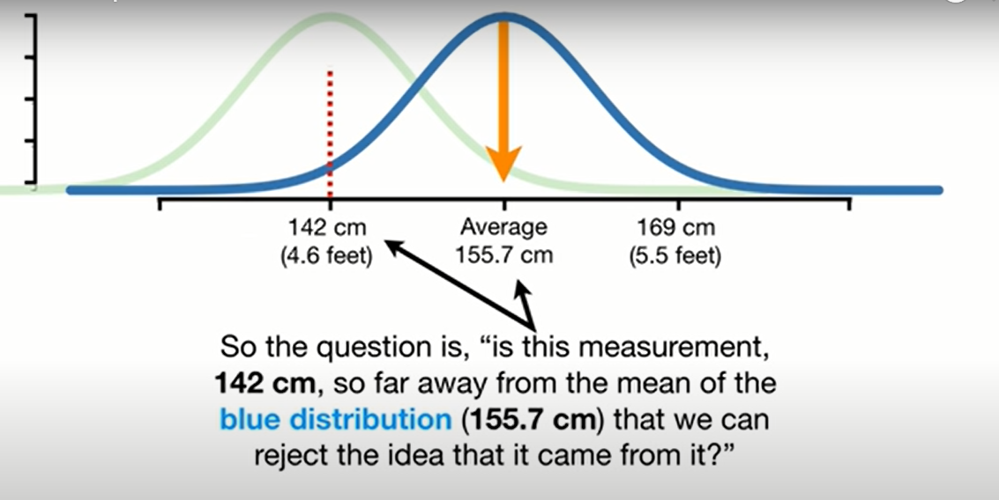

Slide 64
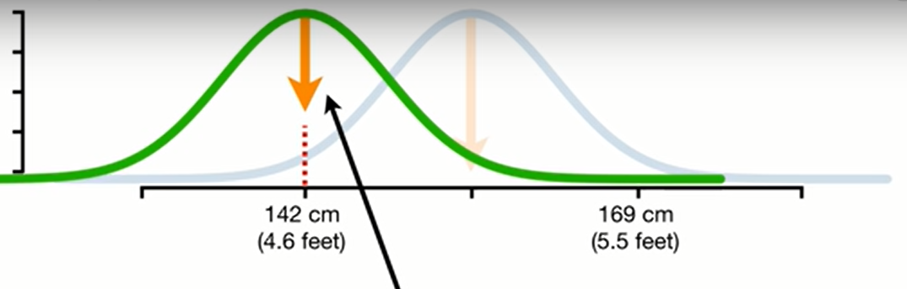
Doing a better job
Notes:
144

Slide 65
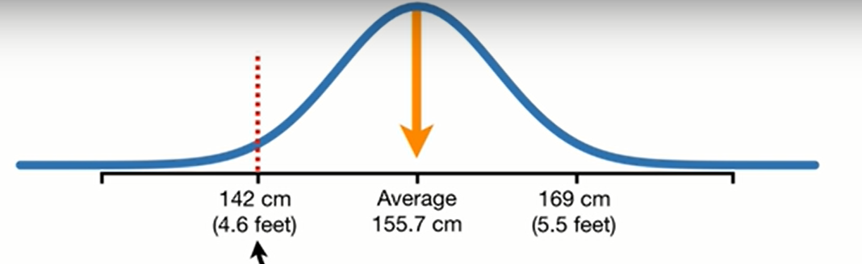
Calculate p value under the null
Which areas should we shade?
Notes:
144

Slide 66
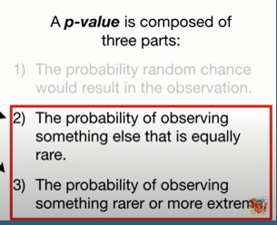
remember

Slide 67
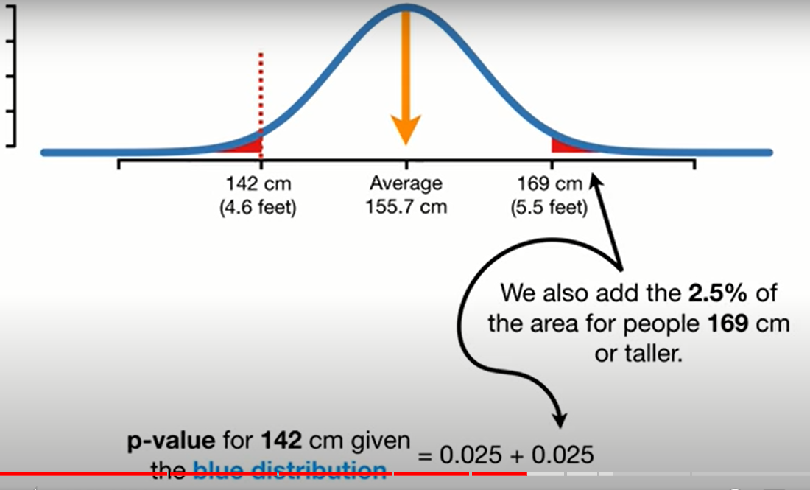
Then compare to a preset threshold

Slide 68
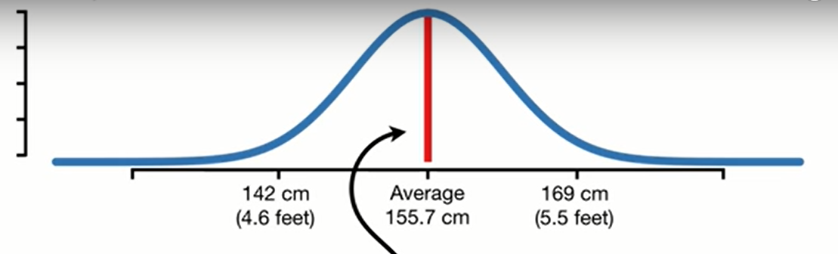
What if we measured someone here?

Slide 70
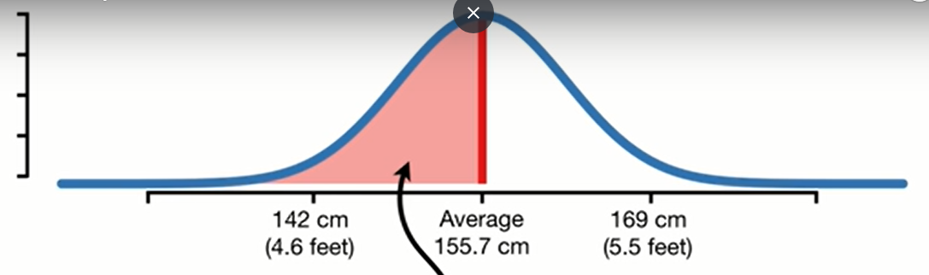
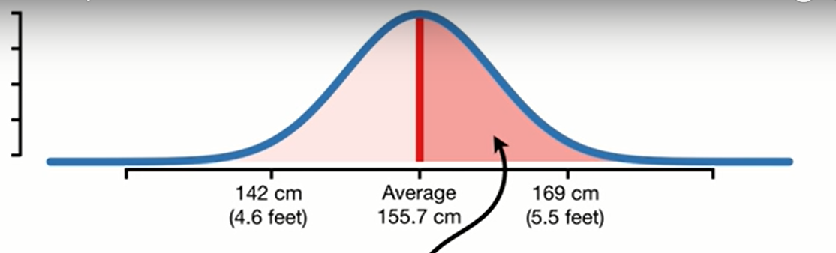
More extreme

Slide 71
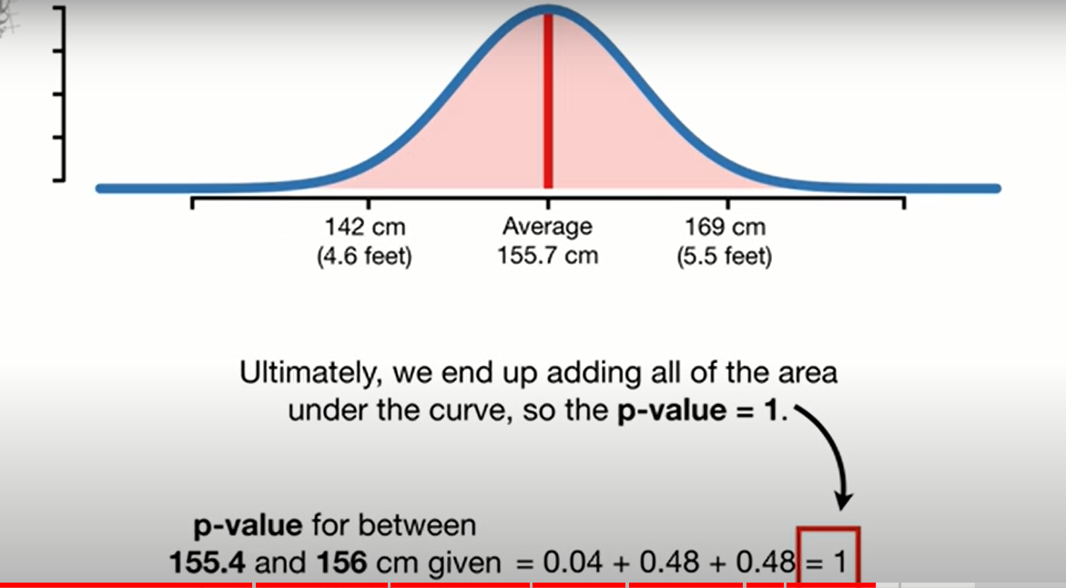

Slide 72
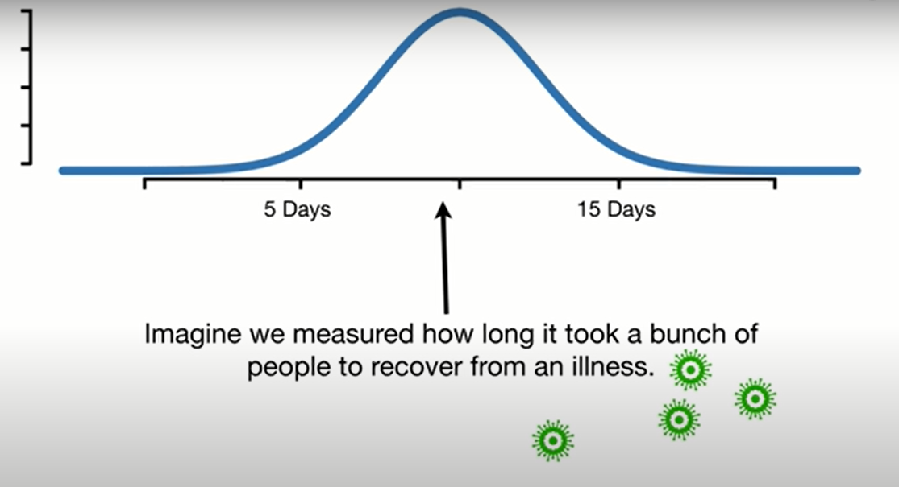
One sided p value

Slide 73
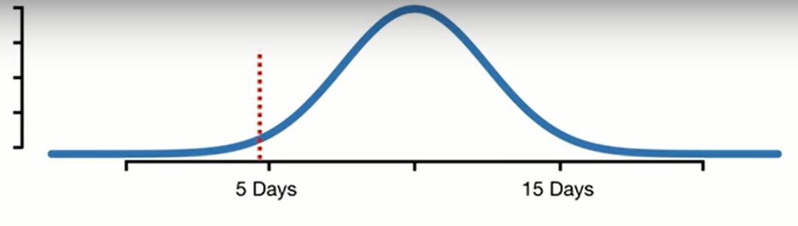
Super drug
Null: days >= 10 Alt days <10
Where are more extreme values?
Notes:
We want to test if superdrug help people recover in a short time
We gave the drug to a bunch of people and the results are the red line
144

Slide 74
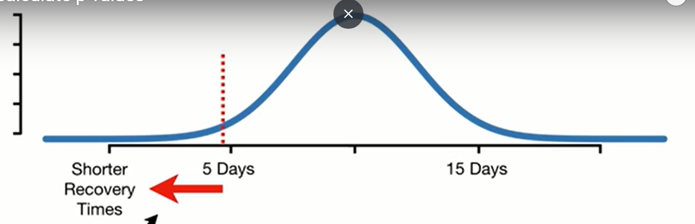
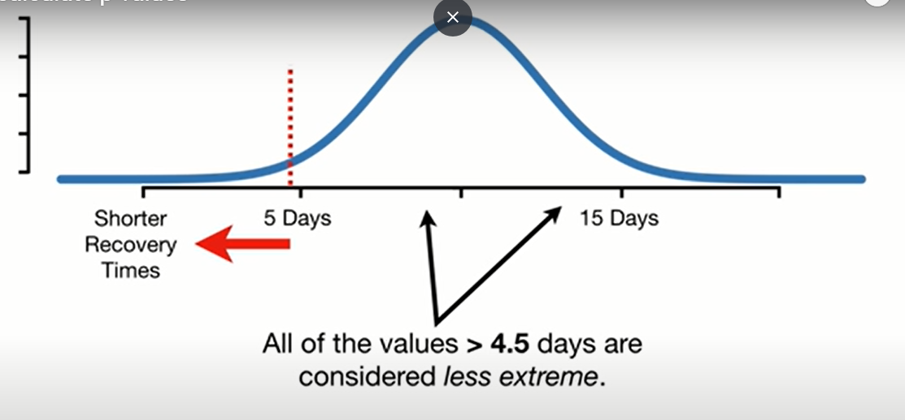

Choose direction
Notes:
144

Slide 75


Slide 76


Slide 77

More info?
Notes:
How to calculate p-values - YouTube
https://www.youtube.com/watch?v=JQc3yx0-Q9E
144

Slide 78



One sided
What if I want two sided?
Notes:
Imp conclusion
Simulate the values of your statistic that are possible from the null.
Calculate the value of the statistic you actually obtained in your data.
Compare your statistic to the values from the null.
Calculate the proportion of null values that are considered extreme based on your alternative.
144

Slide 79


Notes:
144

Slide 80


P values Pitfalls?

Slide 81


P hacking
Notes:
p-hacking, or cheating on a p-value | Freakonometrics
https://freakonometrics.hypotheses.org/19817
144

Slide 82

Confidence interval

Slide 83
الملتقى
Classical tests( t test/ chi square / ANOVA/ .. )
Central limit theorem
Bootstrapping
Newer tests
Notes:
144

Slide 84
Confidence intervals
Many ways to calculate them
We will use the one with bootstrap
https://rpsychologist.com/d3/ci/

Slide 85



Notes:
Some samples included more than once
Others weren’t included
144

Slide 86


Repeat previous steps
What about 99%
confidence interval?
Notes:
Same but covers 99% of the means
144

Slide 87


Slide 88

Solution
Outside CI
i.e. significant

Slide 89

More info?
Notes:
StatQuest: Confidence Intervals - YouTube
https://www.youtube.com/watch?v=TqOeMYtOc1w
144

Slide 90


Any advantages?
Panadol vs Tramadol
Notes:
While the P-value interpretations only differ between results with P < 0.05 and P > 0.05, the confidence interval approach offers five different interpretations, (1) statistically significant and important difference, (2) statistically significant difference which may be important, (3) not statistically significant though A may be better by an important amount, (4) not statistically significant and if there is a difference it is not important, and (5) inconclusive, as an important difference (in both directions) is possible.
Considerations for the design, analysis and presentation of in vivo studies - ScienceDirect
https://www.sciencedirect.com/science/article/pii/S1063458416301911#fig1
144

Slide 91
Any advantages?
Direction
Effect Size
significance
Error
Notes:
While the P-value interpretations only differ between results with P < 0.05 and P > 0.05, the confidence interval approach offers five different interpretations, (1) statistically significant and important difference, (2) statistically significant difference which may be important, (3) not statistically significant though A may be better by an important amount, (4) not statistically significant and if there is a difference it is not important, and (5) inconclusive, as an important difference (in both directions) is possible.
Considerations for the design, analysis and presentation of in vivo studies - ScienceDirect
https://www.sciencedirect.com/science/article/pii/S1063458416301911#fig1
144

Slide 92

Difference

Slide 93

ratio

Slide 94

reporting

Slide 95

Notes:
Confidence interval or p-value?: part 4 of a series on evaluation of scientific publications - PubMed
https://pubmed.ncbi.nlm.nih.gov/19547734/
144

Slide 96
Statistical workflow
how to handle statistical problems?
Good, bad, ugly, better??
Notes:
There is no single method.
No method would say no. It just spits out answers. Thus, decisions are taken
What’s the worst and what’s the best?
144

Slide 97


Slide 98

🖌

Slide 99


Slide 100


Slide 101


Slide 102


Slide 103

Notes:
Center is at 1 for ratios
For ratios, 1 means similar
Ratios are the relative space while difference is the absolute space and is centered at 0

Slide 104


Slide 105


Slide 106


Slide 107


Slide 108

Notes:
U could say instead : inconclusive difference
Or the estimate for the difference was … with … CI
The later reporting gives the reader the chance to analyze the results on his own and judge whether these differences are important or not.

Slide 109


Slide 110

Trial

Slide 111

Notes:
5 felt better
3 worse
Mean = 0.5
Is the drug effective ?
144

Slide 112

Random things we can’t control?
How to draw valid conclusions?
Notes:
Why 0.5 not 0?
Maybe the 5 respondents had adopted a good lifestyle and the other 3 had a worse lifestyle
144

Slide 113

population

Slide 114

Repeat experiment?
Notes:
144

Slide 115


Sampling Distribution
Any better option?
Notes:
Mean close to 0 most of the time
Mean away from 0 rarely
Concluision: Drug is not effective
However, Time money effort availability issues
144

Slide 116

bridge the gap … assumptions
assume Normal

Slide 117

pros
Notes:
which_test_flowchart.png (6131×2669)
https://onishlab.colostate.edu/wp-content/uploads/2019/07/which_test_flowchart.png
Many tests with relatively high power
144

Slide 118

cons
P value parametric: 0.04
P value non par. : 0.63
Notes:
Look at mean and median for both males and female
Look how females are right skewed
GraphPad Prism 9 Statistics Guide - The Mann-Whitney test doesn't really compare medians
https://www.graphpad.com/guides/prism/latest/statistics/stat_nonparametric_tests_dont_compa.htm
144

Slide 119
How to check normality?
Notes:
which_test_flowchart.png (6131×2669)
https://onishlab.colostate.edu/wp-content/uploads/2019/07/which_test_flowchart.png
144

Slide 120



Normality tests

Slide 121

Assume normal sample distribution
Notes:
Law of large numbers: the larger the sample size, the closest ur sample statistics to the population parameter
The Central Limit Theorem states that with a large enough sample size the sampling distribution of the mean will be normally distributed.
The Central Limit Theorem actually applies for these well known statistics:
Sample means (\bar{x}x¯)
Sample proportions (pp)
Difference in sample means (\bar{x}_1 - \bar{x}_2x¯1​−x¯2​)
Difference in sample proportions (p_1 - p_2p1​−p2​)
And it applies for additional statistics, but it doesn't apply for all statistics! . You will see more on this towards the end of this lesson.
144

Slide 122


Notes:
Sample variances are actually known to follow a different type of mathematical distribution known as a chi-squared distribution. Which is a more right-skewed distribution than a normal.
144

Slide 123

Do not rely on CLT
Notes:
In the next concepts, you will see that the with large sample sizes the sampling distribution of certain statistics will never become normally distributed. So how do we know which statistics will follow normal distributions, and which will not?
So, you might be wondering already why is the Central Limit Theorem such a big deal? In our new age of computers, it probably isn't as big of a deal, but more on this coming up soon!
Instead of relying on CLT, we can use bootstrapping
144

Slide 124


bootstrapping
Notes:
bootstrap - Explaining to laypeople why bootstrapping works - Cross Validated
https://stats.stackexchange.com/questions/26088/explaining-to-laypeople-why-bootstrapping-works
The question asks, "if we are resampling from our sample, how is it that we are learning something about the population rather than only about the sample?" Resampling is not done to provide an estimate of the population distribution--we take our sample itself as a model of the population. Rather, resampling is done to provide an estimate of the sampling distribution of the sample statistic in question.
Using random.choice in python actually samples with replacement
144

Slide 125

How to bootstrap?

Slide 126


Sampling with replacement
Same number of measurments

Slide 127

Bootsrapped dataset

Slide 128

Different mean

Slide 129


Slide 130

bootstrapping

Slide 131



Slide 132

End result

Slide 133

Importance

Slide 134

Confidence interval
Does the interval include zero?
Notes:
Thus not significant
144

Slide 135


Fake data

Slide 136


Specific population
Old patients with diabetes

Slide 137

No difference
Are u sure?
Notes:
144

Slide 138
bootstrapping
Get the variation
Notes:
bootstrap - Explaining to laypeople why bootstrapping works - Cross Validated
https://stats.stackexchange.com/questions/26088/explaining-to-laypeople-why-bootstrapping-works
The question asks, "if we are resampling from our sample, how is it that we are learning something about the population rather than only about the sample?" Resampling is not done to provide an estimate of the population distribution--we take our sample itself as a model of the population. Rather, resampling is done to provide an estimate of the sampling distribution of the sample statistic in question.
Using random.choice in python actually samples with replacement
144

Slide 139


Bootstrapping instead of t-test
T-test – Python for Data Science
https://pythonfordatascienceorg.wordpress.com/independent-t-test-python/
Notes:
Tests for testing assumptions
Plots
Contradicting tests
144

Slide 140
No longer needed!

Slide 141
decisions
How to make decisions with t test?
How to make decisions with bootstrap?
How to make decisions when I use central limit theorem?

Slide 142
الملتقى
Classical tests( t test/ chi square / ANOVA/ .. )
Central limit theorem
Bootstrapping
Newer tests
Notes:
144

Slide 143
Confidence interval
What about 99%
confidence interval?
Notes:
Same but covers 99% of the means
144

Slide 144
Solution
Outside CI
i.e. significant

Slide 145

P value with bootstrapping

Slide 146
Different types of bootstrapping
parametric
Semi parametric
Non parametric
Pros and cons
Notes:
144

Slide 147




Bottom line
bootstrap
std
Notes:
144

Slide 148


Easier way?
Notes:
bootstrapped · PyPI
https://pypi.org/project/bootstrapped/
144

Slide 149


Slide 150
Advanced
Notes:
Sampling Distribution of the Sample Proportion, p-hat » Biostatistics » College of Public Health and Health Professions » University of Florida
https://bolt.mph.ufl.edu/6050-6052/module-9/sampling-distribution-of-p-hat/
144

Slide 151

advanced
Notes:
Jan Vanhove :: Some illustrations of bootstrapping
https://janhove.github.io/teaching/2016/12/20/bootstrapping
<number>

Slide 152

advanced
Notes:
Parametric or non-parametric bootstrap
https://influentialpoints.com/Training/nonparametric-or-parametric_bootstrap.htm
<number>

